Slide 1
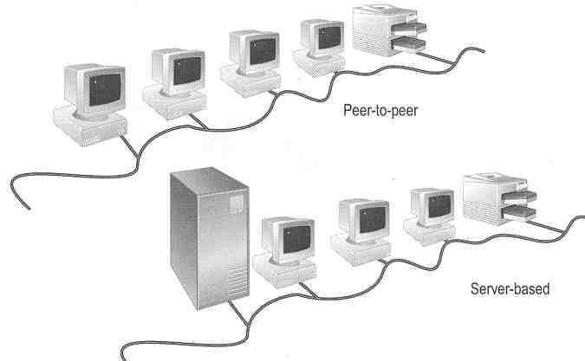
5. Introduction to Networking

Slide 2
References
Held G., “Internetworking LANs and WANs – Concepts, Techniques and Methods”, Wiley, 2nd Ed., 1998
  Comment: Good at concepts
Stallings W., “Data and Computer Communications”, Prentice Hall, 7th Ed., 2004
  Comment: Good at concepts and very up-to-date
Forouzan B. A, “Data Communications and Networking”, McGraw-Hill, 2nd Ed., 2000
  Comment: Many good revision questions at ends of chapters
Redmond W., “MCSE Training Kit: Networking Essentials Plus”, Microsoft Press, 2000
  Comment: Practical oriented

Slide 3
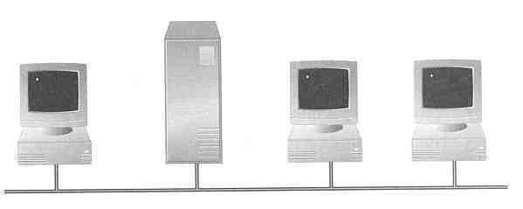

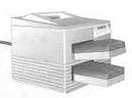
What is a Network?
A network consists of 2 or more computers connected together, and they can communicate and share resources (e.g. information)

Slide 4
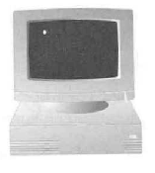

Why Networking?
Sharing information — i.e. data communication
Do you prefer these?
Or this?

Slide 5
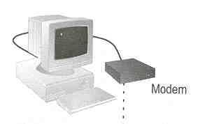
Sharing hardware or software
E.g. print document
Centralize administration and support
E.g. Internet-based, so everyone can access the same administrative or support application from their PCs

Slide 6
How many kinds of Networks?
Depending on one’s perspective, we can classify networks in different ways
  Based on transmission media: Wired (UTP, coaxial cables, fiber-optic cables) and Wireless
  Based on network size: LAN and WAN (and MAN)
  Based on management method: Peer-to-peer and Client/Server
  Based on topology (connectivity): Bus, Star, Ring …
  :
  :

Slide 7
Transmission Media
Two main categories:
  Guided ― wires, cables
  Unguided ― wireless transmission, e.g. radio, microwave, infrared, sound, sonar
We will concentrate on guided media here:
  Twisted-Pair cables:
    Unshielded Twisted-Pair (UTP) cables
    Shielded Twisted-Pair (STP) cables
  Coaxial cables
  Fiber-optic cables

Slide 8
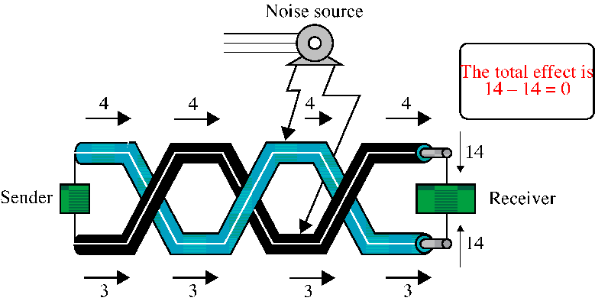
Twisted-Pair Cables
If the pair of wires are not twisted, electromagnetic noises from, e.g., motors, will affect the closer wire more than the further one, thereby causing errors

Slide 9
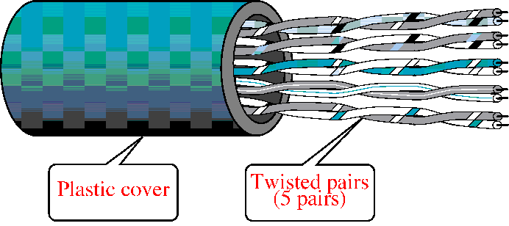
Unshielded Twisted-Pair (UTP)
Typically wrapped inside a plastic cover (for mechanical protection)
A sample UTP cable with 5 unshielded twisted pairs of wires
Insulator
Metal

Slide 10
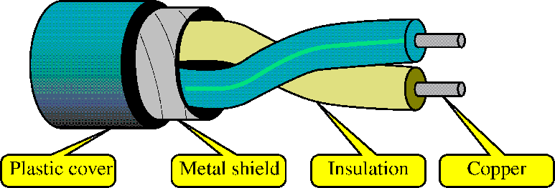
Shielded Twisted-Pair (STP)
STP cables are similar to UTP cables, except there is a metal foil or braided-metal-mesh cover that encases each pair of insulated wires

Slide 11
Categories of UTP Cables
EIA classifies UTP cables according to the quality:
Category 1 ― the lowest quality, only good for voice, mainly found in very old buildings, not recommended now
Category 2 ― good for voice and low data rates (up to 4Mbps for low-speed token ring networks)
Category 3 ― at least 3 twists per foot, for up to 10 Mbps (common in phone networks in residential buildings)
Category 4 ― up to 16 Mbps (mainly for token rings)
Category 5 (or 5e) ― up to 100 Mbps (common for networks targeted for high-speed data communications)
Category 6 ― more twists than Cat 5, up to 1 Gbps

Slide 12
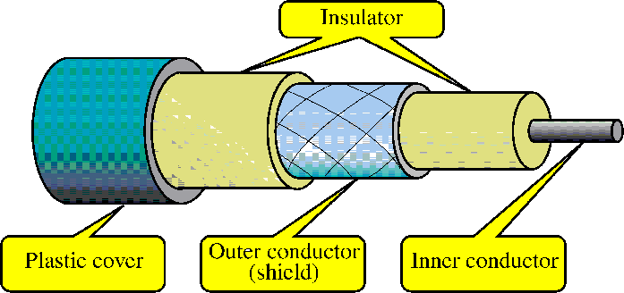
Coaxial Cables
In general, coaxial cables, or coax, carry signals of higher freq (100KHz–500MHz) than UTP cables
Outer metallic wrapping serves both as a shield against noise and as the second conductor that completes the circuit

Slide 13
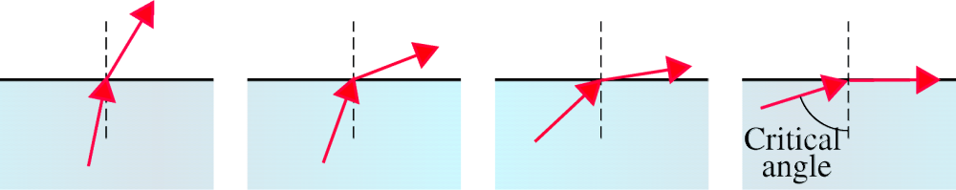
Fiber-Optic Cables
Light travels at 3×10⁸ ms⁻¹ in free space and is the fastest possible speed in the Universe
Light slows down in denser media, e.g. glass
Refraction occurs at interface, with light bending away from the normal when it enters a less dense medium
Beyond the critical angle ⇒ total internal reflection

Slide 14
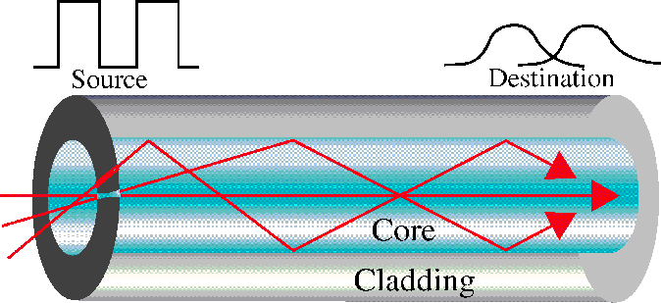
An optical fiber consists of a core (denser material) and a cladding (less dense material)
Simplest one is a multimode step-index optical fiber
Multimode = multiple paths, whereas step-index = refractive index follows a step-function profile (i.e. an abrupt change of refractive index between the core and the cladding)
Light bounces back and forth along the core
Common light sources: LEDs and lasers

Slide 15
Advantages and Disadvantages
Noise resistance ― external light is blocked by outer jacket
Less signal attenuation ― a signal can run for miles without regeneration (currently, the lowest measured loss is about ~4% or 0.16dB per km)
Higher bandwidth ― currently, limits on data rates come from the signal generation/reception technology, not the fiber itself
Cost ― Optical fibers are expensive
Installation/maintenance ― any crack in the core will degrade the signal, and all connections must be perfectly aligned

Slide 16
LAN and WAN
Local Area Network (LAN)
  Small network, short distance
    A room, a floor, a building
    Limited by no. of computers and distance covered
    Usually one kind of technology throughout the LAN
    Serve a department within an organization
  Examples:
    Network inside the Student Computer Room
    Network inside CF502
    Network inside your home

Slide 17
Wide Area Network (WAN)
  A network that uses long-range telecommunication links to connect 2 or more LANs/computers housed in different places far apart.
    Towns, states, countries
  Examples:
    Network of our Campus
    Internet
Your home
WAN
USA
Student Computer Centre

Slide 18
Example WAN technologies:
  ISDN – Integrated Service Digital Network
    Basic rate: 192 Kbps Primary rate: 1.544Mbps
  T-Carriers ― basically digital phone lines
    T1: 1.544Mbps T3: 28×T1
  Frame relay
    Each link offers 1.544Mbps or even higher
  ATM – Asynchronous Transfer Mode
    Support B-ISDN: 155Mbps or 622Mbps or higher
  SONET – Synchronous Optical Network
    Basic rate OC1: 51.84Mbps
    Support OC12 and up to OC192 (9953.28Mbps) or even higher in the future

Slide 19
Example of WAN: Broadband Cable Network
Cable TV services have been extensively developed in most modern cities
Cable TV companies try to make use of their coaxial cable installed (that are supposed to carry TV signals) to deliver broadband data services
Many cable network wiring has been replaced with hybrid fiber-coax (HFC) ― i.e. use of fiber-optic cable to connect to the subscribers’ buildings, and then the original coaxial cable to connect to each household

Slide 20

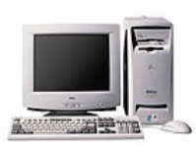
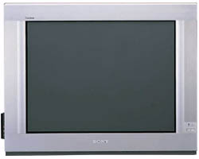
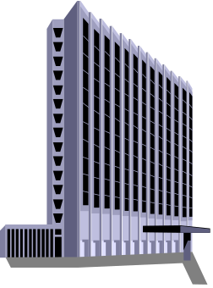
The connection is shared by a number of subscribers, hence may raise performance and security problems
PC
TV
Fiber-optic cable
Cable Drop
Coaxial
Cable
Cable company

Slide 21

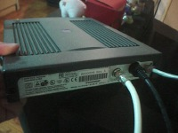
Cable is an asymmetrical technology
  Downstream: max 36 Mbps
  Upstream: max 10 Mbps
May be reduced to 3 – 10 Mbps downstream and 2 Mbps upstream, depending on no. of subscribers
Need a special cable modem
Ethernet
link to PC
Teryon Cable Modem
Coaxial link
from cable TV
socket

Slide 22
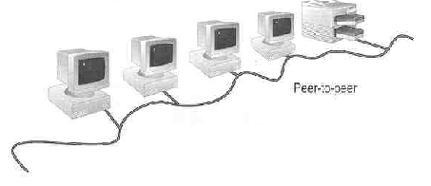
Peer-to-Peer Networks
Peer-to-peer network is also called workgroup
No hierarchy among computers ⇒ all are equal
No administrator responsible for the network
Peer-to-peer

Slide 23
Advantages of peer-to-peer networks:
  Low cost
  Simple to configure
  User has full accessibility of the computer
Disadvantages of peer-to-peer networks:
  May have duplication in resources
  Difficult to uphold security policy
  Difficult to handle uneven loading
Where peer-to-peer network is appropriate:
  10 or less users
  No specialized services required
  Security is not an issue
  Only limited growth in the foreseeable future

Slide 24
Clients and Servers
  Network Clients (Workstation)
    Computers that request network resources or services
  Network Servers
    Computers that manage and provide network resources and services to clients
      Usually have more processing power, memory and hard disk space than clients
      Run Network Operating System that can manage not only data, but also users, groups, security, and applications on the network
      Servers often have a more stringent requirement on its performance and reliability

Slide 25
Advantages of client/server networks
  Facilitate resource sharing – centrally administrate and control
  Facilitate system backup and improve fault tolerance
  Enhance security – only administrator can have access to Server
  Support more users – difficult to achieve with peer-to-peer networks
Disadvantages of client/server networks
  High cost for Servers
  Need expert to configure the network
  Introduce a single point of failure to the system

Slide 26
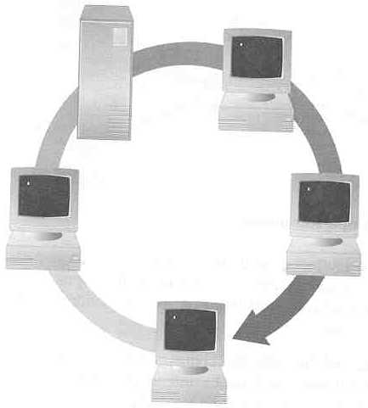
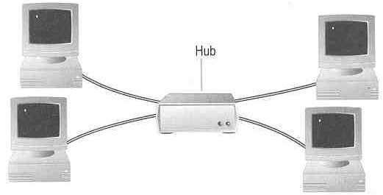
Topology ― 3 basic types
How so many computers are connected together?
  Bus Topology Ring Topology
  Star Topology
Hub

Slide 27
  Bus Topology
    Simple and low-cost
    A single cable called a trunk (backbone, segment)
    Only one computer can send messages at a time
    Passive topology - computer only listen for, not regenerate data
  Star Topology
    Each computer has a cable connected to a single point
    More cabling, hence higher cost
    All signals transmission through the hub; if down, entire network down
    Depending on the intelligence of hub, two or more computers may send message at the same time

Slide 28
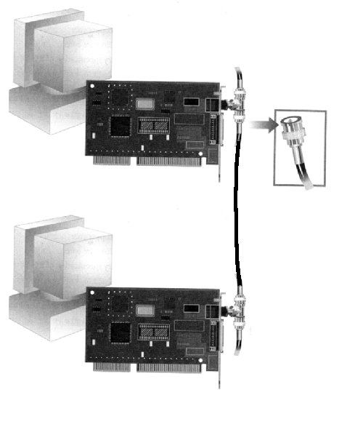
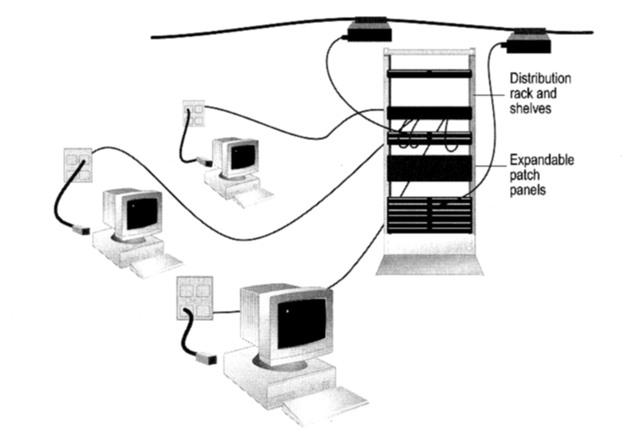
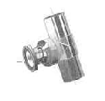
How to construct a network with Bus / Star Topology?
  Bus Topology
Coaxial cable
  Star Topology
BNC T-Connector
Network Card

Slide 29
Ring Topology
  Every computer serves as
  a repeater to boost signals
  Typical way to send data:
    Token passing
      only the computer who
      gets the token can send
      data
  Disadvantages
    Difficult to add computers
    More expensive
    If one computer fails, whole network fails
Ack
T
T
T
T
T
data
data
data
data
T
data
T
T
T
Ack
T
T
data
Ack
T
T
Ack

